Slide 1
Deep Learning by
Ajay Sharma

Slide 2
What is Learning
What is learning ?
The learning is the process of examining the change that occurs in the surrounding environment and based on historical data establishing some rule to predict the future.
What is machine learning ?
Machine learning is a growing technology which enables computers to learn automatically from past data. Machine learning uses various algorithms for building mathematical models and making predictions using historical data or information.

Slide 3
Historical trend in Deep Learning
Deep learning has become more useful as the amount of available training data has increased.
Deep learning models have grown in size over time as computer hardware and software infrastructure for deep learning has improved.
Deep learning has solved increasingly complicated applications with increasing accuracy over time.

Slide 4
Linear Algebra
Scalar: A scalar is just a single number, in contrast to most of the other objects studied in linear algebra, which are usually arrays of multiple numbers.
Vectors: A vector is an array of numbers. The numbers are arranged in order. We can identify each individual number by its index in that ordering.
Matrices: A matrix is a 2-D array of numbers, so each element is identified by two indices instead of just one.

Slide 5
Tensor and Norm
Tensors: In some cases we will need an array with more than two axes. In the general case, an array of numbers arranged on a regular grid with a variable number of axes is known as a tensor.
Norms : A Norm is a function used to measure the size of a vector.
Formally Lp norm is given by the relation

Slide 6
Contd.
For p∈ℝ, p≥1.
Normally norms are the function mapping vectors to non-negative values. More rigorously, a norm is any function f that satisfies the following properties:
f(x)=0 ⇒ x = 0
f (x + y) ≤ f(x) + f(y) (the triangle inequality)
∀α ∈ R, f(αx) = |α|f(x)
The L² norm, with p = 2, is known as the Euclidean norm.

Slide 7
Contd.
L∞ norm, also known as the max norm is defined as
To measure the size of a matrix Frobenius norm is used and is defined as

Slide 8
Eigen Decomposition
One of the most widely used kinds of matrix composition is called eigen decomposition, in which we decompose a matrix into a set of eigenvectors and eigenvalues.
An eigenvector of a square matrix A is a non-zero vector v such that multiplication by A alters only the scale of v:
Av = λv.
The scalar λ is known as the eigenvalue corresponding to this eigenvector.

Slide 9
Cntd.
Suppose that a matrix A has n linearly independent eigenvectors, {v⁽¹⁾ , . . . ,v^{(n)}}, with corresponding eigenvalues {λ₁, . . . , λ_{n} }. We may concatenate all of the eigenvectors to form a matrix V with one eigenvector per column: V = [v⁽¹⁾ , . . . ,v^{(n)}]. Likewise, we can concatenate the eigenvalues to form a vector λ = [λ₁, . . . , λ_{n} ]^{T.} The eigen decomposition of A is then given by
A = V diag(λ)V ⁻¹.

Slide 10
Singular Value Decomposition(SVD)
The singular value decomposition is similar, except this time we will write A as a product of three matrices
A = UDV^{T}
Suppose that A is an m×n matrix. Then U is defined to be an m×m matrix, D to be an m× n matrix, and V to be an n × n matrix. The matrices U and V are both defined to be orthogonal matrices. The matrix D is defined to be a diagonal matrix and need not to be a square matrix.

Slide 11
Trace and Determinant of a matrix
The elements along the diagonal of D are known as the singular values of the matrix A. The columns of U are known as the left-singular vectors. The columns of V are known as as the right-singular vectors.
The trace operator gives the sum of all of the diagonal entries of a matrix

Slide 12
Contd.
The trace operator provides an alternative way of writing the Frobenius norm of a matrix
The determinant of a square matrix, denoted det(A), is a function mapping matrices to real scalars.
The determinant is equal to the product of all the eigenvalues of the matrix

Slide 13
Contd.
i.e. , if λ₁, λ₂ , λ₃ , ………… λ_{n} are the eigenvalues of a matrix A, then
λ₁ λ₂ λ₃………… λ_{n} = det(A)
The sum of all eigenvalues of a matrix A is equal to the trace of the same matrix A.
λ₁ +λ₂ +λ₃ + …………+ λ_{n} = Tr(A)

Slide 14
Probability and Information Theory
Probability theory is a mathematical framework for representing uncertain statements.
It provides a means of quantifying uncertainty and axioms for deriving new uncertain statements.
In artificial intelligence applications, we use probability theory in two major ways.

Slide 15
Cont.
First, the laws of probability tell us how AI systems should reason, so we design our algorithms to compute or approximate various expressions derived using probability theory.
Second, we can use probability and statistics to theoretically analyze the behavior of proposed AI systems

Slide 16
Random Variable
A random variable is a variable that can take on different values randomly. Random variables may be discrete or continuous.
A discrete random variable is one that has a finite or countably infinite number of states.
A continuous random variable is associated with a real value.

Slide 17
Probability Distribution
A probability distribution is a description of how likely a random variable or set of random variables is to take on each of its possible states.
A probability distribution over discrete variables may be described using a probability mass function (PMF). We typically denote probability mass functions with a capital P.

Slide 18
Contd.
To be a probability mass function on a random variable x, a function P must satisfy the following properties
The domain of P must be the set of all possible states of x.
∀x ∈ x, 0 ≤ P(x) ≤ 1. An impossible event has probability 0 and no state can be less probable than that. Likewise, an event that is guaranteed to happen has probability 1, and no state can have a greater chance of occurring.

Slide 19
Contd.
. We refer to this property as being normalized .
Continuous random variables describes probability distributions using a probability density function (PDF).
To be a probability density function, a function p must satisfy the following properties

Slide 20
Contd.
The domain of must be the set of p all possible states of x.
∀x ∈ x, p(x) ≥ 0. Note that we do not require p(x) ≤ 1.
.
A probability density function p(x) does not give the probability of a specific state directly, instead the probability of landing inside an infinitesimal region with volume δx is given by p(x)δx.

Slide 21
Marginal Probability and Conditional Probability
The probability distribution over the subset is known as the marginal probability distribution.
suppose we have discrete random variables x and y, and we know P(x, y). We can find P(x) with the sum rule
For a continuous variable summation is replaced over integration

Slide 22
Contd.
Conditional probability is the probability of some event, given that some other event has happened.
We denote the conditional probability that y = y given x = x as P (y = y | x = x).
So
The conditional probability is only defined when P( x = x) > 0.

Slide 23
Contd.
Chain rule or product rule of probability can be defined as
P(x⁽¹⁾, . . . , x^{(n)} ) = ( P ^{x(1)})Π^{n}_{i =2}P(x^{(i)} | x⁽¹⁾, . . . , x^{(i−1)}).
Two random variables x and y are independent if their probability distribution can be expressed as a product of two factors, one involving only x and one involving only y.
∀x ∈ x, y ∈ y, p(x = x, y = y) = p(x = x)p(y = y)

Slide 24
Contd.
Two random variables x and y are conditionally independent given a random variable z if the conditional probability distribution over x and y factorizes in this way for every value of z.
∀x ∈ x, y ∈ y, z ∈ z, p(x = x, y = y | z = z) = p(x = x | z = z)p(y = y | z = z).

Slide 25
Probability Distribution
The Bernoulli distribution is a distribution over a single binary random variable φ ∈(0,1).
P(x = x) = φ^{x}(1 − φ)^{1−x}
P(x=0)=1- φ
P(x=1)= φ
E(x)= φ
Var(x)= φ(1- φ)

Slide 26
Contd.
The most commonly used distribution over real numbers is the normal distribution, also known as the Gaussian distribution
The two parameters μ ∈ R and σ ∈ (0, ∞) control the normal distribution.
A normal distribution with μ=0 and σ=1 is called standard normal distribution.

Slide 27
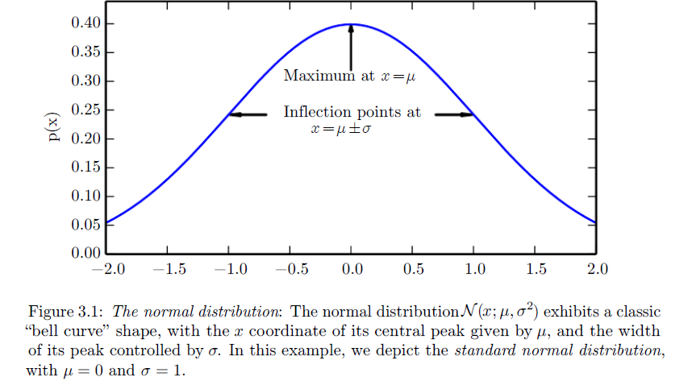
Normal Distribution

Slide 28
Multinomial distribution
Let N_{i} denote the number of results in category i in a sequence of independent trials with probability p_{i} for a result in the i^{th} category on each trail, 1≤i≤m, where p₁+p₂+……..+p_{m}=1. then for every m-tuple of non-negative integers(n₁,n₂,……,n_{m}) with n

Slide 29
Bayes Theorem
Let E₁, E₂,…, E_{n} be a set of events associated with a sample space S, where all the events E₁, E₂,…, E_{n} have nonzero probability of occurrence and they form a partition of S. Let A be any event associated with S, then according to Bayes theorem

Slide 30
Entropy
The entropy value gives us the amount of uncertainty present in an entire probability distribution. It can be computed using the following relations
H(x)= -E[log(p(x)]
where E represents expectation of a variable.
If we have two separate probability distributions P ( x ) and Q(x) over the same random variable x , we can measure how different these two distributions are using the Kullback-Leibler (KL) divergence

Slide 31
Structured probabilistic models
Machine learning algorithms often involve probability distributions over a very large number of random variables. Using a single function to describe the entire joint probability distribution can be very inefficient (both computationally and statistically).
Instead of using a single function to represent a probability distribution, we can split a probability distribution into many factors that we multiply together.
For example, suppose we have three random variables: a, b and c. suppose that a influences the value of b and b influences the value of c, but that a and c are independent given b. We can represent the probability distribution over all three variables as a product of probability distributions over two variables
p(a, b, c) = p(a)p(b | a)p(c | b)

Slide 32
Contd.
These factorizations can greatly reduce the number of parameters needed to describe the distribution
We can describe these kinds of factorizations using graphs.
When we represent the factorization of a probability distribution with a graph, we call it a structured probabilistic model or graphical model.
There are two main kinds of structured probabilistic models: directed and undirected.
Both kinds of graphical models use a graph G in which each node in the graph corresponds to a random variable, and an edge connecting two random variables means that the probability distribution is able to represent direct interactions between those two random variables.

Slide 33
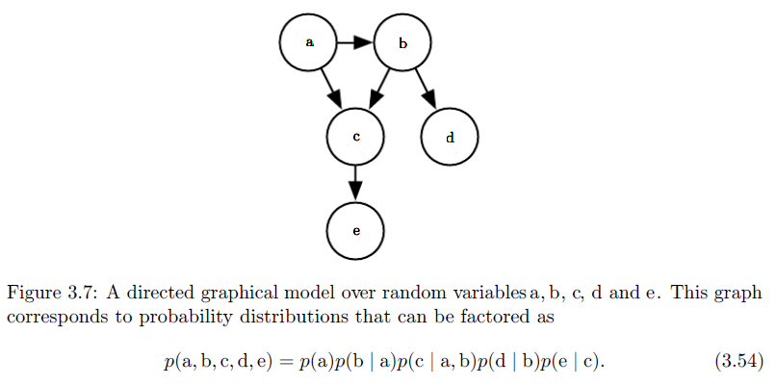
Contd.

Slide 34
Overflow and Underflow
The fundamental difficulty in performing continuous math on a digital computer is that we need to represent infinitely many real numbers with a finite number of bit patterns. This means that for almost all real numbers, we incur some approximation error when we represent the number in the computer.
One form of rounding error that is particularly devastating is underflow. Underflow occurs when numbers near zero are rounded to zero
For example, we usually want to avoid division by zero (some software environments will raise exceptions when this occurs, others will return a result with a placeholder not-a-number value).

Slide 35
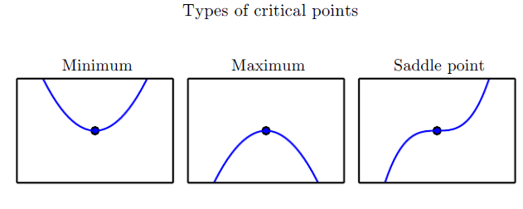
Optimization
Another highly damaging form of numerical error is overflow. Overflow occurs when numbers with large magnitude are approximated as ∞ or −∞. Further arithmetic will usually change these infinite values into not-a-number values.

Slide 36
Gradient descent method
For functions with multiple inputs, we must make use of the concept of partial derivatives. The partial derivative measures how f changes as only the variable x_{i} increases at point x.
The gradient generalizes the notion of derivative to the case where the derivative is with respect to a vector: the gradient of f is the vector containing all of the partial derivatives, denoted ∇_{x}f (x )

Slide 37
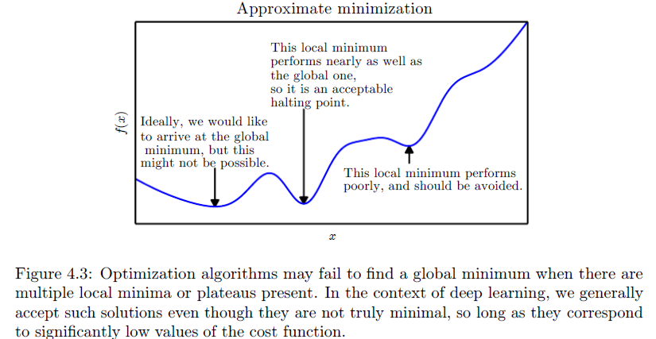
Contd.

Slide 38
Contd.
The directional derivative in direction u (a unit vector) is the slope of the function f in direction u.
In other words, the directional derivative is the derivative of the function f (x + αu) with respect to α , evaluated at α = 0.
To minimize f , we would like to find the direction in which f decreases the fastest. We can do this using the directional derivative.
To minimize f , we would like to find the direction in which f decreases the fastest.

Slide 39
Contd.
We can do this using the directional derivative
where θ is the angle between u and the gradient. Substituting in ||u||₂ = 1 and ignoring factors that do not depend on u, this simplifies to min u cos θ.
This is minimized when u points in the opposite direction as the gradient. In other words, the gradient points directly uphill, and the negative gradient points directly downhill.

Slide 40
Contd.
This is known as the method of steepest descent or gradient descent.
Steepest descent proposes a new point
Where ε is the learning rate, a positive scalar determining the size of the step.
We can choose ε in several different ways. A popular approach is to set ε to a small constant. Sometimes, we can solve for the step size that makes the directional derivative vanish.

Slide 41
Contd.
Steepest descent converges when every element of the gradient is zero (or, in practice, very close to zero).
Although gradient descent is limited to optimization in continuous spaces, the general concept of making small moves (that are approximately the best small move) towards better configurations can be generalized to discrete spaces.
Ascending an objective function of discrete parameters is called hill climbing.

Slide 42
Jacobian and Hessian Matrices
Sometimes we need to find all of the partial derivatives of a function whose input and output are both vectors. The matrix containing all such partial derivatives is known as a Jacobian matrix.
If we have a function , then the Jacobian matrix
of f is defined such that .
For a function , the derivative with respect to x_{i} of the derivative of f with respect to x_{j} is denoted as .

Slide 43
Contd.
In a single dimension, we can denote by or .
This is important because it tells us whether a gradient step will cause as much of an improvement as we would expect based on the gradient alone.
We can think of the second derivative as measuring curvature.

Slide 44
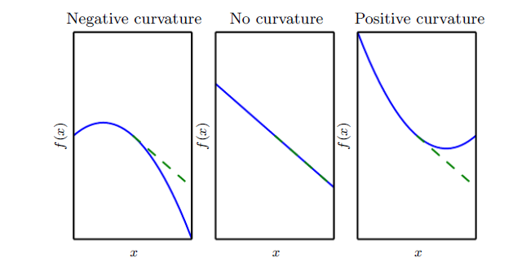
Contd.
Positive, Negative and No Curvature.

Slide 45
Contd.
When our function has multiple input dimensions, there are many second derivatives. These derivatives can be collected together into a matrix called the Hessian matrix. The Hessian matrix H(f)(x) is defined such that
Hessian matrix is symmetric i.e. H_{i,j}=H_{j,i} .
Because the Hessian matrix is real and symmetric, we can decompose it into a set of real eigenvalues and an orthogonal basis of eigenvectors.

Slide 46
Contd.
The second derivative in a specific direction represented by a unit vector d is given by d^{T}Hd. When d is an eigenvector of H, the second derivative in that direction is given by the corresponding eigenvalue.
For other directions of d, the directional second derivative is a weighted average of all of the eigenvalues, with weights between 0 and 1, and eigenvectors that have smaller angle with d receiving more weight.
The maximum eigenvalue determines the maximum second derivative and the minimum eigenvalue determines the minimum second derivative.

Slide 47
Contd.
We can make a second-order Taylor series approximation to the function around f(x) the current point x⁽⁰⁾
where g is the gradient and H is the Hessian at x⁽⁰⁾.
If we use a learning rate of ε, then the new point x will be given by x⁽⁰⁾-εg. Thus we get
There are three terms here: the original value of the function, the expected improvement due to the slope of the function, and the correction we must apply to account for the curvature of the function.

Slide 48
Contd.
When this last term is too large, the gradient descent step can actually move uphill. When g^{T}Hg is zero or negative, the Taylor series approximation predicts that increasing ε forever will decrease f forever.
When g^{T}Hg is positive, solving for the optimal step size that decreases the Taylor series approximation of the function the most yields

Slide 49
Contd.
The simplest method for doing so is known as Newton’s method. Newton’s method is based on using a second-order Taylor series expansion to approximate f(x) near some point x⁽⁰⁾
If we then solve for the critical point of this function, we obtain

Slide 50
Constrained Optimization
Sometimes we wish not only to maximize or minimize a function f(x ) over all possible values of x. Instead we may wish to find the maximal or minimal value of f (x) for values of x in some set S. This is known as constrained optimization.
The Karush–Kuhn–Tucker (KKT) approach provides a very general solution to constrained optimization. With the KKT approach, we introduce a new function called the generalized Lagrangian or generalized Lagrange function.
To define the Lagrangian, we first need to describe S in terms of equations and inequalities.
We want a description of S in terms of m functions g^{(i)} and n functions h^{(j)} so that S= {x | ∀i, g^{(i)}(x) = 0 and ∀j, h^{(j)}(x) ≤ 0}

Slide 51
Contd.
We introduce new variables λi and αj for each constraint, these are called the KKT multipliers. The generalized Lagrangian is then defined as
We can now solve a constrained minimization problem using unconstrained optimization of the generalized Lagrangian. Observe that, so long as at least one feasible point exists and f(x) is not permitted to have value ∞, then

Slide 52
Contd.
For example Suppose we want to find the value of x that minimizes
Now , .
We can then follow this gradient downhill, taking small steps.

Slide 53
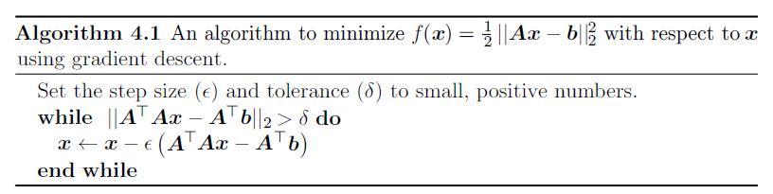
Contd.

Slide 54
Contd.
Now suppose we wish to minimize the same function, but subject to the constraint x^{T}x ≤ 1. To do so, we introduce the Lagrangian
L(x, λ) = f(x) + λ(x^{T}x − 1)
By differentiating the Lagrangian with respect to x, we obtain the equation
A^{T}Ax − A^{T}b + 2λx = 0.
This tells us that the solution will take the form
x = (A^{T}A + 2λI)⁻¹A^{T}b
The magnitude of λ must be chosen such that the result obeys the constraint. We can find this value by performing gradient ascent on λ. To do so, observe

Slide 55
Contd.
When the norm of x exceeds 1, this derivative is positive, so to follow the derivative uphill and increase the Lagrangian with respect to λ, we increase λ.
The process of solving the linear equation and adjusting λ continues until x has the correct norm and the derivative on λ is 0.

Slide 56
Learning Algorithm
In a learning algorithm a computer program is said to learn from experience E with respect to some class of tasks T and performance measure P , if its performance at tasks in T , as measured by P , improves with experience E.
Many kinds of tasks can be solved with machine learning. Some of the most common machine learning tasks include the following
Classification
Regression
Machine Translation
Denoising

Slide 57
Contd.
Machine learning algorithms can be broadly categorized as unsupervised or supervised by what kind of experience they are allowed to have during the learning process.
Most of the learning algorithms in this book can be understood as being allowed to experience an entire dataset.
Supervised learning algorithms experience a dataset containing features, but each example is also associated with a label or target.
Unsupervised learning algorithms experience a dataset containing many features, then learn useful properties of the structure of this dataset.

Slide 58
Contd.
Roughly speaking, unsupervised learning involves observing several examples of a random vector x, and attempting to implicitly or explicitly learn the probability distribution p(x), or some interesting properties of that distribution, while supervised learning involves observing several examples of a random vector x and an associated value or vector y, and learning to predict y from x, usually by estimating p(y | x).
The term supervised learning originates from the view of the target y being provided by an instructor or teacher who shows the machine learning system what to do. In unsupervised learning, there is no instructor or teacher, and the algorithm must learn to make sense of the data without this guide.

Slide 59
Capacity, Underfitting and Overfitting
The factors determining how well a machine learning algorithm will perform are its ability to
Make the training error small
Make the gap between training and test error small
Underfitting occurs when the model is not able to obtain a sufficiently low error value on the training set.
Overfitting occurs when the gap between the training error and test error is too large.
A model’s capacity is its ability to fit a wide variety of function.

Slide 60
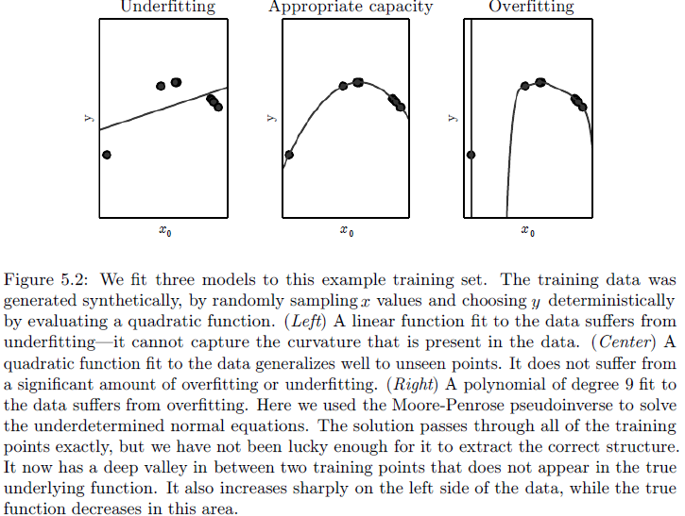
Contd.

Slide 61
Contd.
Models with low capacity may struggle to fit the training set. Models with high capacity can overfit by memorizing properties of the training set that do not serve them well on the test set.

Slide 62
Baysian classifier
As discussed in the previous slide Bayes rule is defined using the formula
where,
P(A/B) is Posterior probability: Probability of hypothesis A on the observed event B.
P(B/A) is Likelihood probability: Probability of the evidence given that the probability of a hypothesis is true.
P(A) is Prior probability: Probability of a hypothesis before observing the evidence.
P(B) is Marginal probability: Probability of evidence.
Suppose we have a dataset of whether condition and target value play. So using this dataset we need to decide that whether we should play or not on a particular day according to the whether condition.

Slide 63
Contd.
Outlook Play
1 | Rainy | Yes
2 | Sunny | Yes
3 | Overcast | Yes
4 | Overcast | Yes
5 | Sunny | No
6 | Rainy | Yes
7 | Sunny | Yes
8 | Overcast | Yes
9 | Rainy | No
10 | Sunny | No
11 | Sunny | Yes
12 | Rainy | No
13 | Overcast | Yes
14 | Overcast | Yes

Slide 64
Building a Machine Learning Algorithm
Nearly all deep learning algorithms can be described as particular instances of a fairly simple recipe
Combine a specification of a dataset
A cost function
An optimization procedure
A model
Many machine learning problems become exceedingly difficult when the number of dimensions in the data is high. This phenomenon is known as the curse of dimensionality.

Slide 65
Module 2: Artificial Neural Network
Artificial Neural Networks (ANN) are algorithms based on brain function and are used to model complicated patterns and forecast issues.
The Artificial Neural Network (ANN) is a deep learning method that arose from the concept of the human brain Biological Neural Networks.
The development of ANN was the result of an attempt to replicate the workings of the human brain.
The workings of ANN are extremely similar to those of biological neural networks, although they are not identical. ANN algorithm accepts only numeric and structured data.

Slide 66
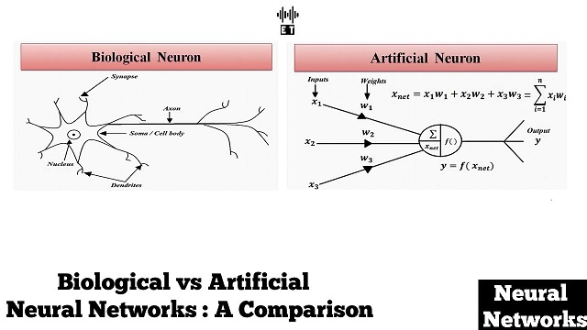
Biological vs Artificial Neural Network

Slide 67
Contd.
A biological neuron is mainly composed of 3 main parts and an external part called synapse.
Dendrites are responsible for getting incoming signals from outside.
Soma is the cell body responsible for the processing of input signals and deciding whether a neuron should fire an output signal.
Axon is responsible for getting processed signals from neuron to relevant cells.
Synapse is the connection between an axon and other neuron dendrites.

Slide 68
Difference between ANN and BNN
Parameters | ANN | BNN
Structure | Input , weight, output and hidden layer | Dendrites, synapse, axon cell body
Learning | very precise structures and formatted data | they can tolerate ambiguity
Processor | Complex high speed one or a few | Simple, low speed and large number
Computing | Centralized sequential stored programs | Distributed parallel self-learning
Reliability | very vulnerable | robust
Expertise | numerical and symbolic manipulations | perceptual problems
Operating Environment | well-defined ,well-constrained | poorly defined un-constrained

Slide 69
McCulloch-Pits Neuron Model
McCulloch-Pitts neuron allows binary 0 or 1 state only, i.e. it is binary activated.
These neurons are connected by direct weight path.
There will be same weights for the connection entering into a particular neuron.
The neuron is associated with the threshold value.
The neuron fires if the net input to the neuron is greater than the threshold.
The threshold is set so that the inhibition is absolute, because, non-zero inhibitory input will prevent the neuron from firing.
It take only one time step for a signal to pass over one connection link.

Slide 70
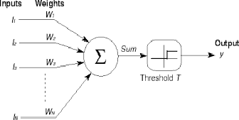
Contd.
The architecture of the McCulloch Pitts Neuron is shown bellow.
y is the McCulloch Pitts neuron, it can receive signal from any number of other neurons.
The connection weights from i₁, i₂, …….,i_{n} are denoted by w.

